Slide 1


PRESENTATION TITLE
MovieBee
Movie Review Application
Neha Balki
Chary Vielma
Vama Trivedi
Keerthi SV
Gabe Salac
02AUG18 - Summer
CPSC473
Professor McCarthy

Slide 2

Slide Title

Slide 3
WHAT IS REACT?
A JavaScript Library for building User Interfaces.
Renders your UI and responds to events.
Uses the concept called Virtual DOM, creates an in-memory data structure cache,enumerates the resulting differences and then updates the browser’s displayed DOM efficiently.
Unique feature : React.js not only perform on client side ,but it can also be rendered on server side and they can work together interoperably.

Slide 4

Slide Title

Slide 5
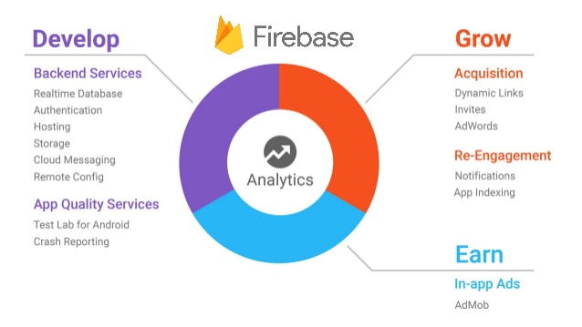

Slide 6
HOW DOES FIREBASE WORK?
Firebase is essentially a real time database.The data appears as JSON files and allows real time changes to occur on the connected client side.When you build cross-platform apps using iOS,Android,Javascript SDKs,your clients end up getting all the data that was updated.
Firebase has support for the web.iOS,OS X and Android clients.It has Node.JS and a Java library designed for server-side use.

Slide 7
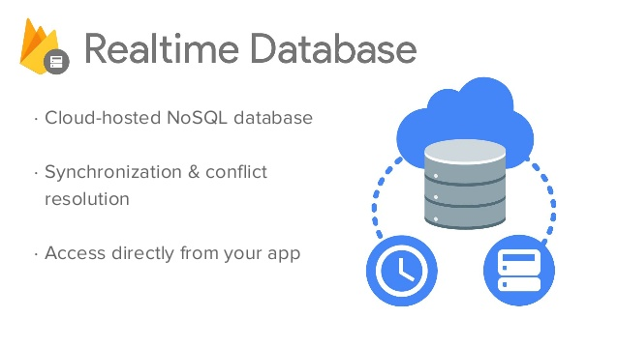

Slide 8
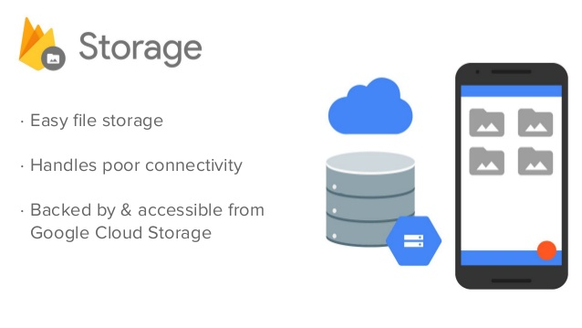

Slide 9
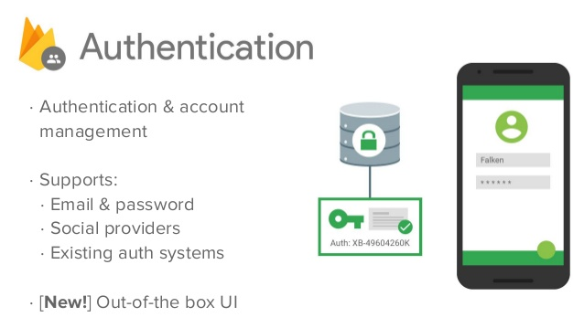

Slide 10
FIREBASE AUTHENTICATION
Firebase Authentication provides backend services,easy to use SDK’s and ready made UI libraries to authenticate users to your app.It supports authentication using passwords,popular federated identity providers like Google,Facebook and more.
Firebase Authentication integrates tightly with other Firebase services and it leverages industry standards like OAuth 2.0 and OpenID connect, so it can be easily integrated with custom backend.
To sign a user into your app, you first get authentication credentials from user, then pass these credentials to the Firebase Authentication SDK. Our backend services will then verify those credentials and return a response to the client.

Slide 11
FIREBASE dependencies
Firebase
React
React-DOM
React-router-DOM
React-Scripts
React-star-rating-component
Notes:
react-router-dom:-the router components for an app development environment using React Native
react-scripts:-react-scripts is a set of scripts from the create-react-app starter pack. create-react-app helps you kick off projects without configuring, so you do not have to setup your project by yourself.

Slide 12
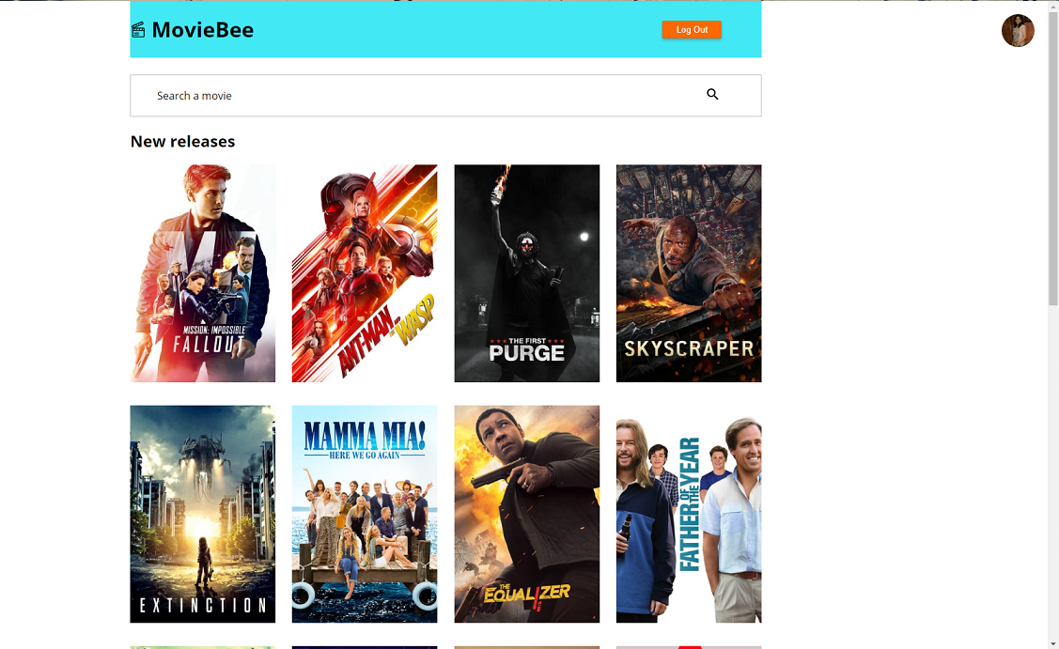

Slide 13
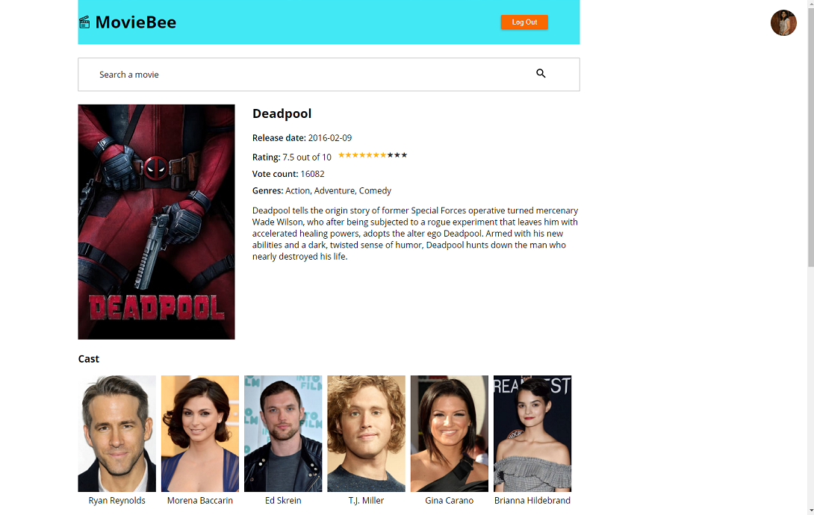

Slide 14


Slide 15
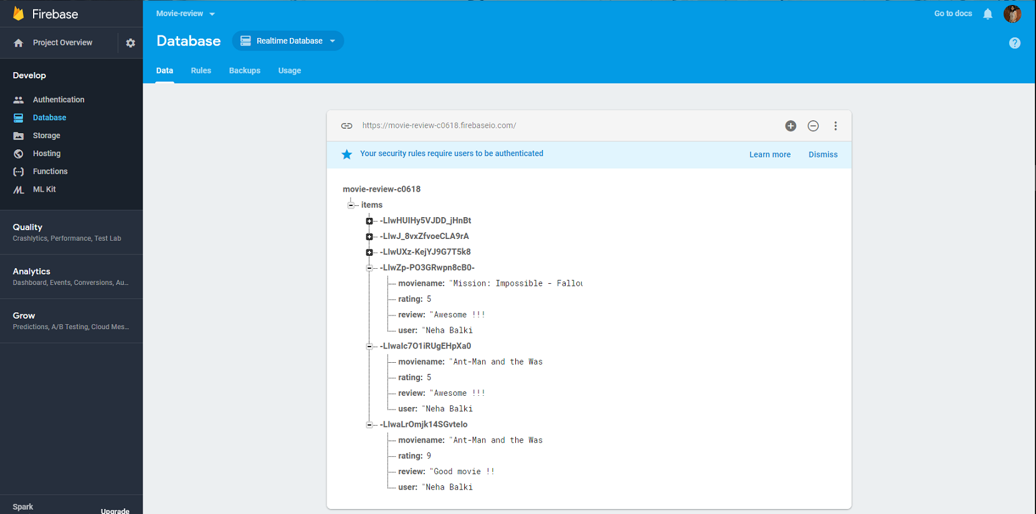

Slide 16
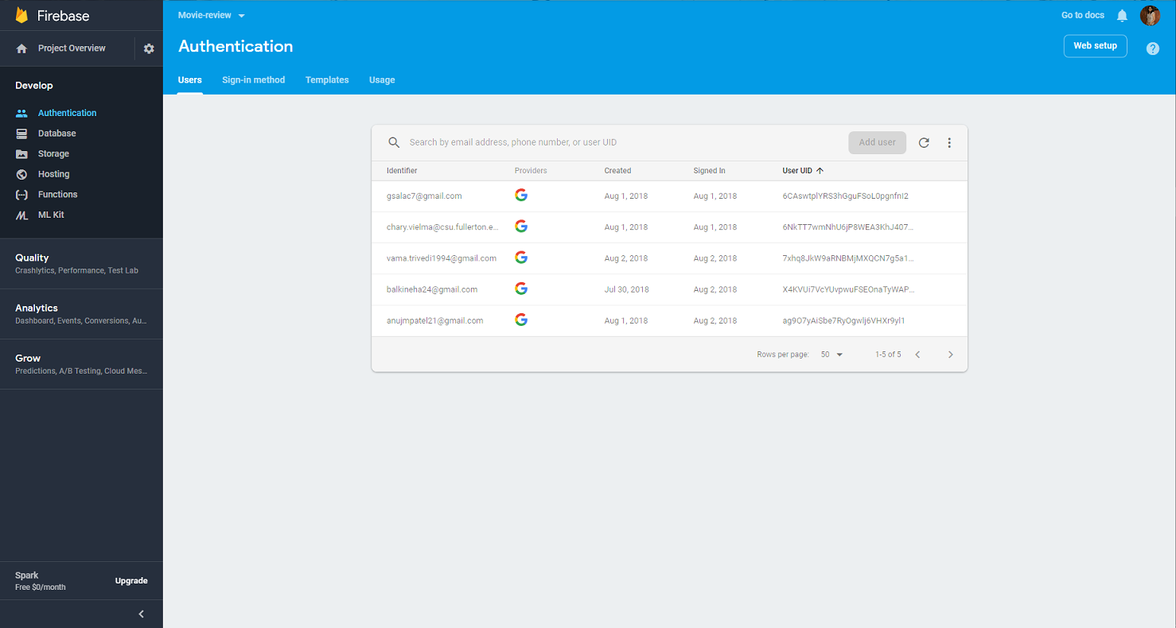

Slide 17
f ReTitlefsfsfsfsd
REFERENCES
<site>
<site>
<site>

Slide 18
Thank you!
Questions?
Neha Balki balkineha_24@csu.fullerton.edu
Chary Vielma chary.vielma@csu.fullerton.edu
Vama Trivedi vama.trivedi1994@gmail.com
Keerthi SV keerthisv@csu.fullerton.edu
Gabe Salac gsalac7@csu.fullerton.edu

